Slide 1


Shri Vishnu Engineering College For Women Autonomous::Bhimavaram
Department of Computer Science & Engineering
Secure notes – “Confidentiality at your finger tips”
Project Guide:
Mr. P. Raju,
Asst. Professor, CSE
Presented By:
B. Tanu Sai Sireesha - 22B01A4603
B. Prasanna - 22B01A4605
B. Lohitha - 22B01A4607
G . Hemalatha - 22B01A4616 V. Samatha - 22B01A4651

Slide 2
INTRODUCTION:
This project seeks to provide secure and efficient administration of personal and professional information by utilizing advanced encryption algorithms and user authentication procedures. In today’s digital landscape, the vulnerability of digital note-taking apps to data breaches highlights the importance of strong security measures. Secure Notes provides a solution by allowing users to create and save their ideas safely. When access to the data is required, users can decrypt them using their username, pass key, restoring the data to its original state. Secure Notes ensures that consumers can protect their valuable information with confidence by prioritizing user-friendly encryption and strict security protocols.

Slide 3
Literature survery
In the "Secure Notes" project, Advanced Encryption Standard (AES) is the primary encryption algorithm used to ensure data security. AES is a symmetric-key algorithm known for its efficiency and strong encryption, making it a widely accepted choice for securing sensitive information. In this project, AES is employed to encrypt notes, links, and passwords before they are stored in the database, ensuring that unauthorized users cannot access the content even if they gain access to the database. The use of AES provides a robust mechanism for maintaining data privacy and confidentiality while allowing for secure storage and retrieval of notes.

Slide 4
Methodology
1.Technologies used:
Analyzed requirements, designed system architecture, and created API endpoints.
Implemented frontend using React.js and backend using Node.js with MongoDB for storage.
2. Encryption Process:
User notes, links, passwords are encrypted using AES and securely stored in
MongoDB.
Notes are decrypted client-side using same secret key which was sent by for encryption.
3.Decryption Process:
The decryption of notes, passwords, and links is achieved using the AES algorithm. The process involves retrieving the same Initialization Vector (IV) that was used during encryption.

Slide 5
WORKFLOW
[Login Page]
| [User Exists?] -- No -- [Register Page] – [Register User] – [Login Page]
|
[Login Successful?] -- No -- [Show Error]
| Yes
[Dashboard]
|
[Write Notes / Passwords / Links and save the data]
|
[Data Encrypted & Stored in MongoDB]
|
[Retrieve]
|
[Encrypted Data Retrieved]
|
[Enter Password]
|
[Password Matched?] -- No -- [Show Error]
|
Yes[Decrypted and data is displayed]

Slide 6

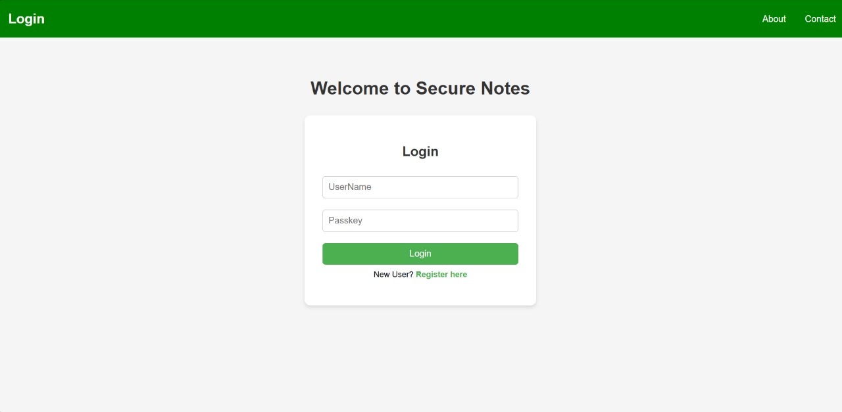
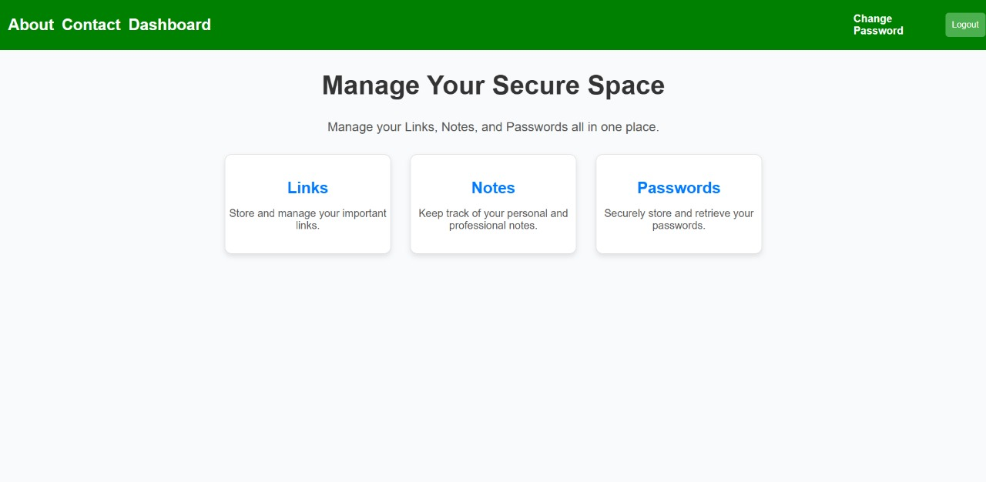
OUTPut screens:

Slide 7
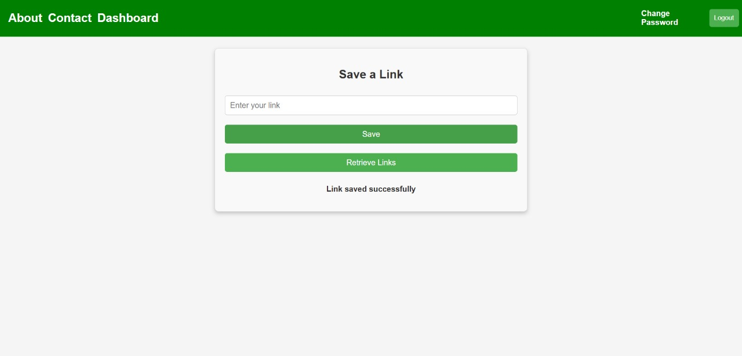
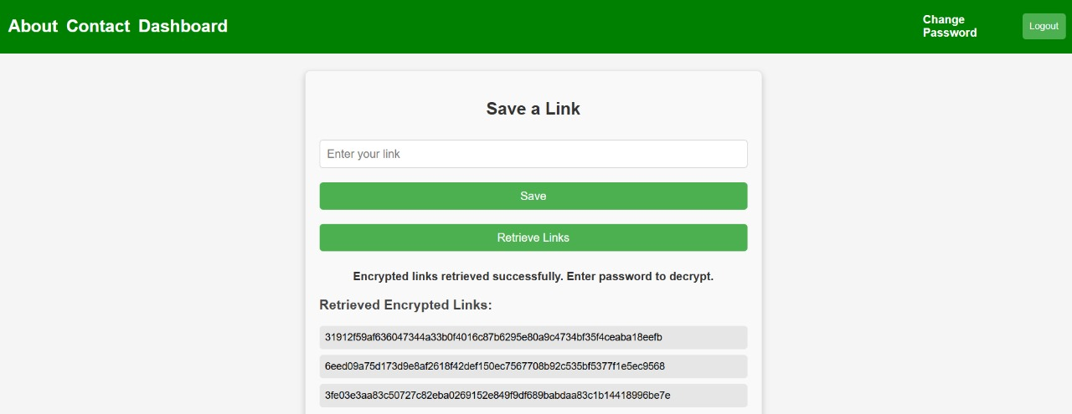
C

Slide 8
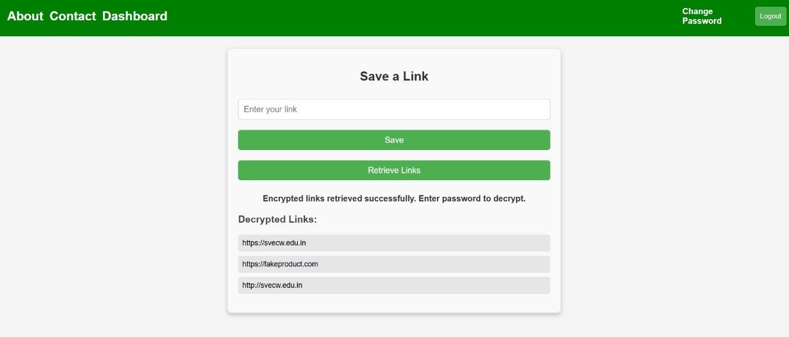
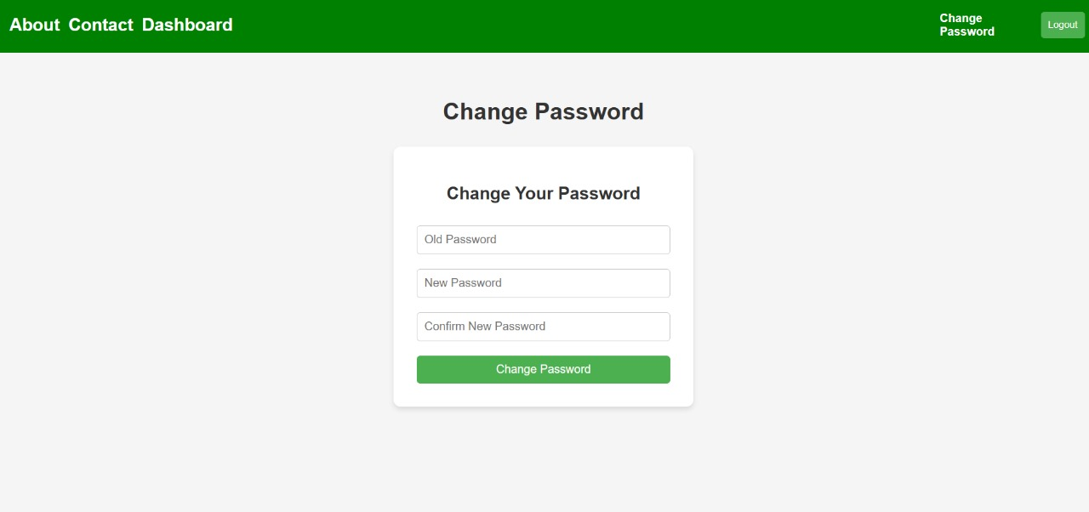
c

Slide 9
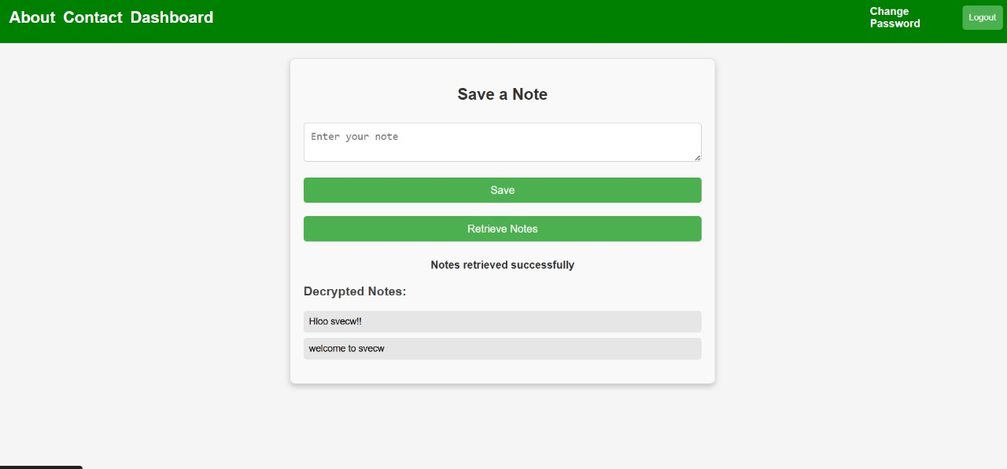
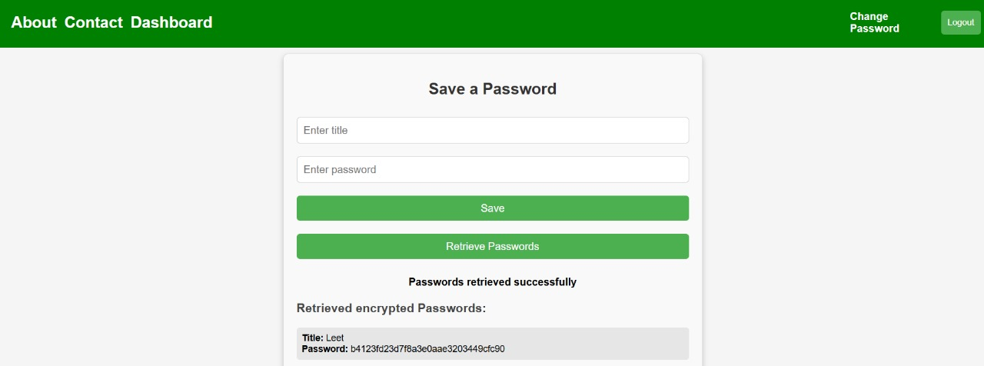
c

Slide 10
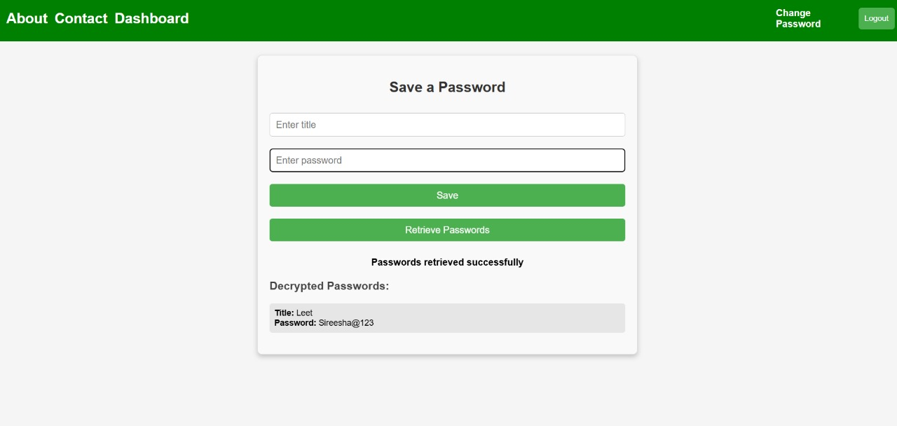
c

Slide 11
Conclusion:
Secure Notes provides a solution to the growing need for secure and efficient note-taking. Its combination of robust encryption, strong authentication, and user-centric design empowers individuals and organizations to manage sensitive information with confidence.

Slide 12
reference:
This project was completed independently from scratch. We referred to ChatGPT for guidance and clarification on specific aspects, including integrating MongoDB Compass as the backend database and implementing secure encryption algorithms like AES. The interactive assistance provided valuable support in streamlining the connection setup and resolving minor issues efficiently.

Slide 13


t

